Slide 1
MEDICINE OF MIDDLE AGES AND RENAISSANCE
Lecturer – Pushina O.S.

Slide 2
PLAN.
Western Europe in the Middle Age
Beliefs about causes of diseases
Surgery and Anatomy
Public Health
The Black Death
Six key changes of Renaissance.
Sickness and medicine in Renaissance.
Syphilis epidemic.

Slide 3
People use the phrase “Middle Ages” to describe Europe between the fall of Rome in 476 AD and the beginning of the Renaissance in the 14th century (1453).

Slide 4
The Early Middle Ages are also known as the Dark Ages.
No scientific accomplishments, no great art produced, no great leaders born.

Slide 5
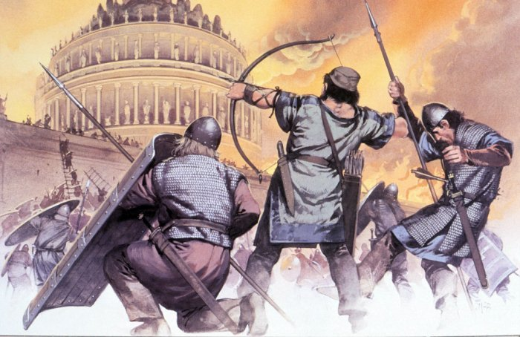
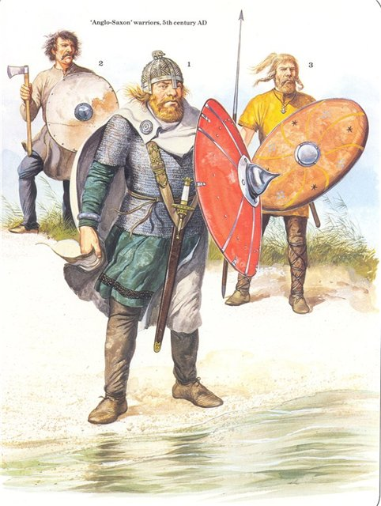
Around 500 AD, hoards of Goths, Vikings, Vandals and Saxons, often collectively referred to as "Barbarians", invaded much of Western Europe.

Slide 6
The whole area broke up into a large number of tiny fiefdoms - territories run by feudal lords.
The feudal lord literally owned his peasants.
These fiefdoms had no public health systems, universities or centers of excellence.

Slide 7
Scientific theories were not exchanged - poor communication.
The only places for learning and studying - monasteries.
In many places only monks knew how to read and write.
Greek and Roman medical records and literature disappeared.

Slide 8
Medical stagnation in Europe
Much medical knowledge from the Ancient world was lost.
The quality of medical practitioners was poor.
The Catholic Church did not allow corpses to be dissected.
People were encouraged to pray and fear of not doing as they were told by Church teachings.

Slide 9
Origin of Disease and Treatment
Sickness – punishment for a sin or a test of faith.
Sole appropriate response - to suffer.
Possible cure -undeserved and unpredictable intervention of God.

Slide 10
Origin of Disease and Treatment
The planets were also responsible for disease – so doctors were good at astrology and astronomy.

Slide 11
Health care givers:
There were many people to go to for diagnosis and treatment:
doctors (very expensive),
monks from the local monastery,
apothecaries ( people who sold herbs and drugs),
local wise men and women.

Slide 12
The Christian hospices were the first ever to be devoted to long-term support of the diseased, poor, and downtrodden.
Enthusiasm, charity, and good cheer sustained those in charge, often women of "good birth“.

Slide 13
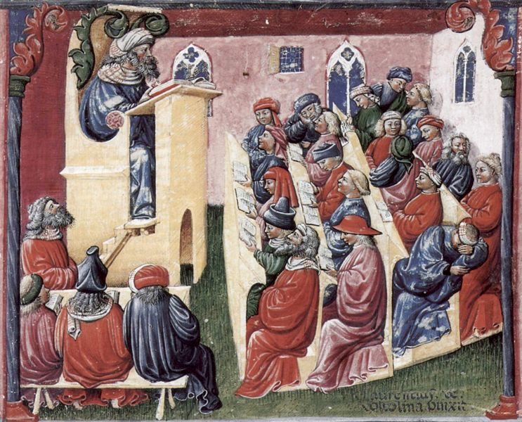
The Rise of the Universities
The first organized medical school in Europe was established at Salerno, in southern Italy in 11 century.
Salerno admitted women as medical students.

Slide 14
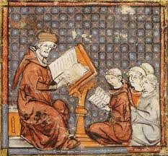
The Rise of the Universities
1088 - University of Bologna
1220 - University of Montpellier
1222 - University of Padua
1425 - University of Leuven

Slide 15
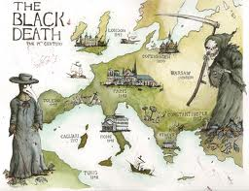
The Black Death

Slide 16
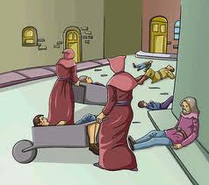
The Black Death
The symptoms of the Black Death were terrible and swift:
Painful swellings (buboes) of the lymph nodes
A bubo was at first a red color. The bubo then turned a dark purple color, or black.
Other symptoms of the Black Death included:
a very high fever
delirium
the victim begins to vomit
muscular pains
bleeding in the lungs
mental disorientation
Victims only lived between 2 -4 days after contracting the deadly disease

Slide 17
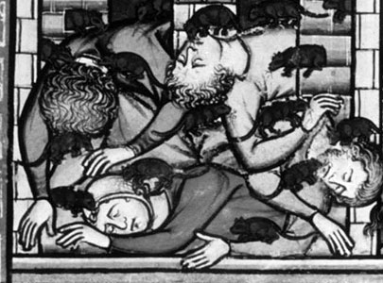
The Black Death
In 1347-9 the Black Death came to Eastern Europe and spread to the west.
The crowded, dirty living conditions of the English cities led to the rapid spread of the disease.
Between 1348 and 1350, the Black Death killed about 30 - 40% of the population of England which was estimated to be about 5 to 6 million.

Slide 18
Surgery
Cauterizing, bandaging, bleeding, and cupping was done by untrained folk doctors, laymen, and charlatans.
Nevertheless some outstanding physicians practiced surgery and wrote about it.

Slide 19
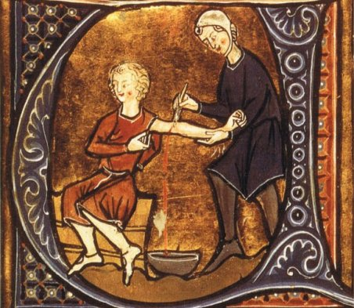
Treatment
Diet was thought extremely important in the treatment of illness.
General reliance was placed on broths, milk, and eggs.
Plant materials were most often used in the preparation of digestives, laxatives, emetics, diuretics, diaphoretics, styptics, and the like.
The most frequently used medication was theriac,
( thought especially effective against poisons).

Slide 20
Arabic Medicine

Slide 21
The contribution of Arabists.
They were also responsible for the establishment of pharmacy and chemistry as sciences.
Methods of extracting and preparing medicines were brought to a high art.
Arabist techniques of distillation, crystallization, solution, sublimation, reduction, and calcination.
Alkali, alcohol, alembic, and elixir…

Slide 22
Methodology and Treatment
Arabist practitioners used essentially the same methods as the Greeks and Romans.
Diagnosis was based on six criteria: the patient's behavior; the excreta; the other effluvia from the body; swellings; the character of pain; and the location of pain.
The properties of the pulse were also carefully noted.

Slide 23
Surgery
The most common surgical technique was cauterization, which he used for both internal and external diseases.
Anesthesia by means of a sponge saturated in a narcotic acid held to the nose and mouth was widespread.

Slide 24
Avicenna
When only 21, he wrote a scientific encyclopedia.
His principal contribution was as a compiler and commentator.
The most renowned of his approximately one hundred books was The Canon
(Al-Qanun).
He suggested the communicable nature of tuberculosis.

Slide 25
MEDICINE OF THE RENAISSANCE

Slide 26
Renaissance means 'rebirth'.
The beginning of the Renaissance is dated from AD 1453, when the fall of Constantinople drove many scholars with knowledge of Greek and Roman learning westwards to about 1750.

Slide 27
SIX KEY CHANGES
Governments were strong and rich.
The economy boomed and trade prospered.
People could afford doctors.

Slide 28
SIX KEY CHANGES
Artists insisted that art had to be based on the most accurate observation possible.
This led them to study the body and visit dissections , and improved
knowledge of anatomy

Slide 29
SIX KEY CHANGES
Revival of learning.
Beginning of scientific method - conducting an experiment, collecting observations, then coming to a conclusion.
This was vital for the development of medicine.

Slide 30
SIX KEY CHANGES
The invention of the
printing press allowed new ideas to spread more quickly around Europe.

Slide 31
SIX KEY CHANGES
The discovery of America by Columbus meant that new foods and medicines were brought back from the New World.

Slide 32
SIX KEY CHANGES
The invention of new weapons
(especially gunpowder)
led to soldiers getting different sorts of wounds, which battlefield doctors had to deal with.

Slide 33
SICKNESS AND MEDICINE IN THE RENAISSANCE ..
In western societies today the infant mortality rate is around 9 per 1000 live births.
In the 1500s it was about 150-200 per 1000 live births.
Moreover, about 50% of children were dead by the age of 15.
Cities tended to be the least healthy, with highly insanitary conditions and people living in close proximity.

Slide 34
People died from a wide variety of ailments: smallpox, plague, dysentery, diphtheria, tuberculosis, scarlet fever, whooping cough, influenza, and pneumonia.
The image to the right, from the 1500s, fittingly shows death conquering all: no-one was immune, even if the rich and well-housed had an advantage.

Slide 35
Syphilis Epidemic
New diseases appeared.
Syphilis and typhus killed many millions.
Syphilis appeared in the early 1490s.
‘Syphilis’, an inexplicably transmitted, devastating, and incurable epidemic (at that time) was spreading wildly, affecting an alarming population.
The name ‘Syphilis’ is derived from Fracastoro's 1530 larger-than-life poem in three books.

Slide 36
Attempts to treat syphilis were probably deliberately harsh, sufferers need do penance as well as receive mercury .
On the right is an image of a small cell in which a patient would endure the torment of isolation, heat and mercury vapor. The caption says ‘for a moment of pleasure, a thousand of suffering’.

Slide 37
Plague also remained one of the biggest takers of human life.

Slide 38
Physicians visited plague patients wearing beaks stuffed with herbs in an attempt to dry the air thought to cause plague.
Secular and religious explanations co-existed.
Holy processions

Slide 39
Most people were treated by:
themselves,
priests,
white witches, who recommended simple herbal remedies
or by especially adult women who had recipe books of family cures.
Robert Burton, explained in 1621. ‘Tis a common practice of some men to go first to a Witch, and then to a Physician; if one cannot, the other shall: if they cannot bend Heaven, they will try Hell.’

Slide 40
Physicians favored the classic remedies of purging and blood letting), changes of diet, light exercise, bathing in sweet waters.
Observation:
checking the patient’s pulse
inspecting his or her urine and stools

Slide 41
The most brilliant anatomist was Andreas Vesalius. Born in Brussels, Vesalius studied medicine in Paris and then took up a chair at the University of Padua in Italy.

Slide 42
THE TABULAE SEX
In 1538 Vesalius published the Tabulae sex.
6 large sheets of drawings.
In some drawings liver had 5 lobes.
One drawing showed 2 lobed liver.
Vesalius was beginning to question what Galen said.

Slide 43
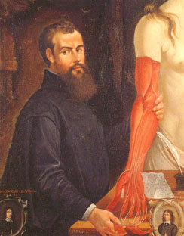
On the Fabric of the Human Body
The pictures were drawn from real human bodies.
Vesalius starts from the outside and works in from skin to bones).
Vesalius corrected some of Galen’s mistakes.

Slide 44
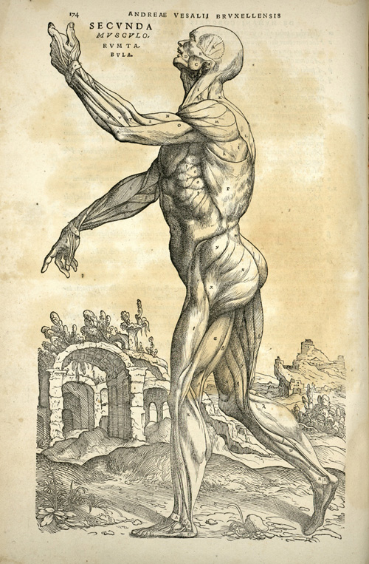
On the Fabric of the Human Body
4. New way of teaching – public dissections backed up with pictures.
5. It was new type of book.
6. Vesalius’ book was printed(not hand written) so there were lots of copies. Soon each medical school in Europe had a copy.

Slide 45
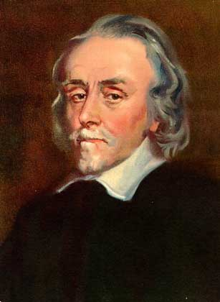
WILLIAM HARVEY
Was born in 1578.
Studied medicine at Padua 1598-1602
Fabricius taught him anatomy
Then worked in London as a doctor and later as lecturer in anatomy at the Royal College of Surgeons
From 1618 was physician to James I and Charles I

Slide 46
1616
He calculated that it was impossible for the blood to be burned up in the muscles (as Galen had claimed).
1628
He published 'Anatomical Account of the Motion of the Heart and Blood', which scientifically proved the principle of the circulation of the blood - the heart acting as a pump and the blood returning via the lungs This book marked the end of Galen's influence on anatomy.

Slide 47
He showed that too much blood leaves the left of the heart in any given time to be fully burnt up by the body and for it to be replaced by the liver.
He also performed a famous experiment involving ligating the arm so as to allow some movement of arterial blood but no movement of venous blood.
This allowed him to demonstrate that veins and arteries are indeed linked together: they are part of a single circulatory system.

Slide 48
Thanks to the labors of men like Vesalius and Harvey, anatomy had become a far more prestigious aspect of medical training

Slide 49
Renaissance surgery
Ambroise Paré changed people's ideas about surgery.
Pare, son of a barber-surgeon, was born in 1510 in France.
Barber-surgeons were the lowest of the low in the 16 century.
When Pare died aged 80 he had been surgeons of 4 successive kings of France
And he was the most famous surgeon of his age.

Slide 50
Ambroise Pare
In 1533 Pare went to Paris to train as barber.
In 1534 he became surgeon of Hotel-Dieu .
In 1537 he left and joined the French army as a military surgeon.
In 1545 he published his first book on the treatment of gunshot wounds , Method of Treating Wounds.
It was written in French, not Latin!

Slide 51
In 1536 he discovered by chance that wounds healed better if they were treated with a 'soothing digestive' (boiled poultice) of yolks and rose oil.
He used catgut ligatures to tie arteries during amputations instead of cauterising the wound.
In 1575 he published his 'Apology and Treatise', with changes to the way surgeons treated wounds and amputations.

Slide 52
Physicians were also increasingly open to new remedies.
In the early 1500s a leading herbal described 258 known plants.
Under a century later the standard botanical text told of around 6000 different plants!

Slide 53
PARACELSUS.

Slide 54
Paracelsus..
In 1527 Paracelsus was appointed town physician and lecturer in Basel.
He invited all people including barber-surgeons to his lecture theatre.
3 weeks later he started his 1 lecture by burning book by Galen and Avicenna.
He lectured in German. Not in Latin.
Galen is a liar and a fake.
Avicenna is a kitchen master. They are good for nothing.
You will not need them. Reading never made a doctor. Patients are the only books.
You will follow me.

Slide 55
Paracelsus
Paracelsus discovered that laudanum (a derivative of opium) was a painkiller that could be used to help his patients.
For many years it was used for general pain such as headaches and period pain (and many people became addicted to it).

Slide 57
‘DOCTRINE OF SIGNATURES.’ Paracelsus, believed that God had left signs in things of the maladies they were designed to treat.
The pomegranate apparently looks a bit like teeth when peeled and so Paracelsus insisted that it was ideal for treating toothache.

Slide 58
Thank you
for
your
attention!

