Slide 1
Social medicine and organization of health protection as science. Subject of method, meaning for practice of health protection
Lecturer – Pushina O.S..

Slide 2
PLAN.
DEFINITION OF THE PUBLIC HEALTH.
WHAT IS HEALTH?
TASKS AND OBJECTIVES.
HISTORY OF PUBLIC HEALTH DEVELOPMENT.
HEALTH OF POPULATION, RISK FACTORS AND METHODS OF ITS STUDY.
6. RESEARCH METHODS IN SOCIAL MEDICINE.
7. QUALITY OF LIFE.

Slide 3
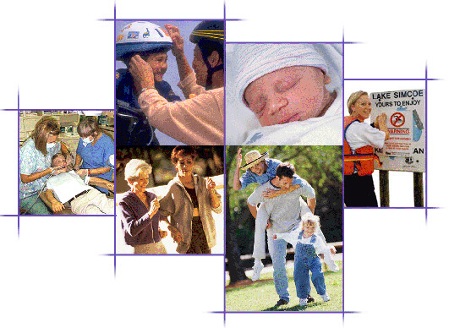
Public health is "the science and art of disease preventing , prolonging life and promoting health
through the organized efforts and informed
choices of society, organizations,
public and private, communities and individuals" (1920, C.E.A. Winslow).

Slide 4
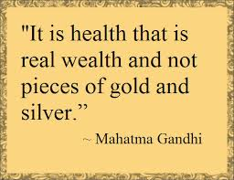
WHAT IS HEALTH?
"a state of complete physical,
mental and social well-being and
not merely
the absence of disease
or infirmity",
as defined
World Health Organization.

Slide 6
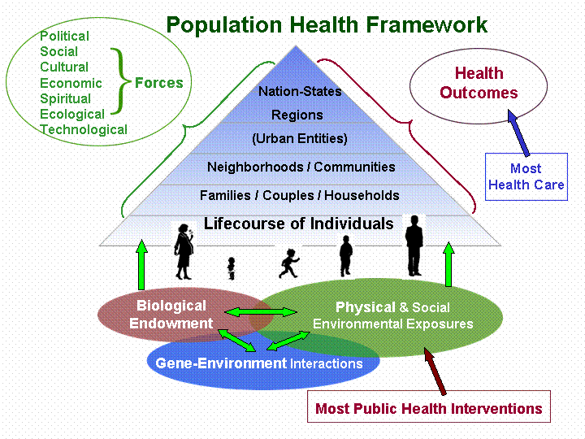
WHO levels of health’ study:
1 level – health of the individual human.
2 level – health of small or ethnic groups – group health.
3 level – population health, that is of people, who live in the state, city, region and etc. )
4 level – public health – public health, health of country, continent, of the world, of population, in whole.

Slide 7
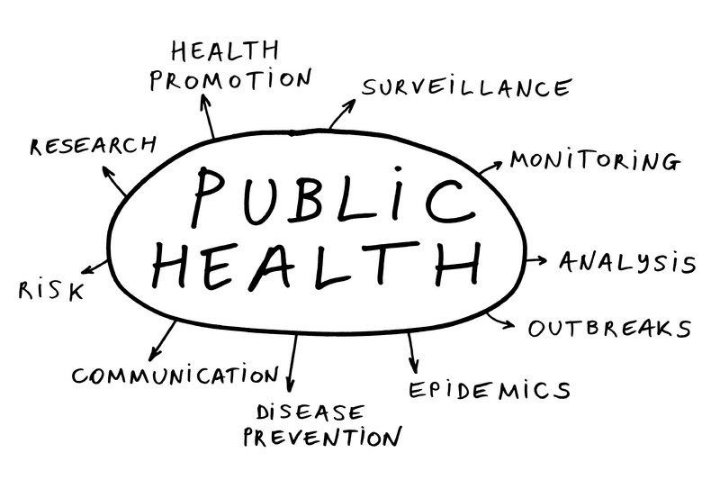
The focus of public health intervention is
to improve health and quality of life
through the prevention and treatment of disease and other physical and mental
health conditions, through surveillance of cases and
the promotion of healthy behaviors.

Slide 8
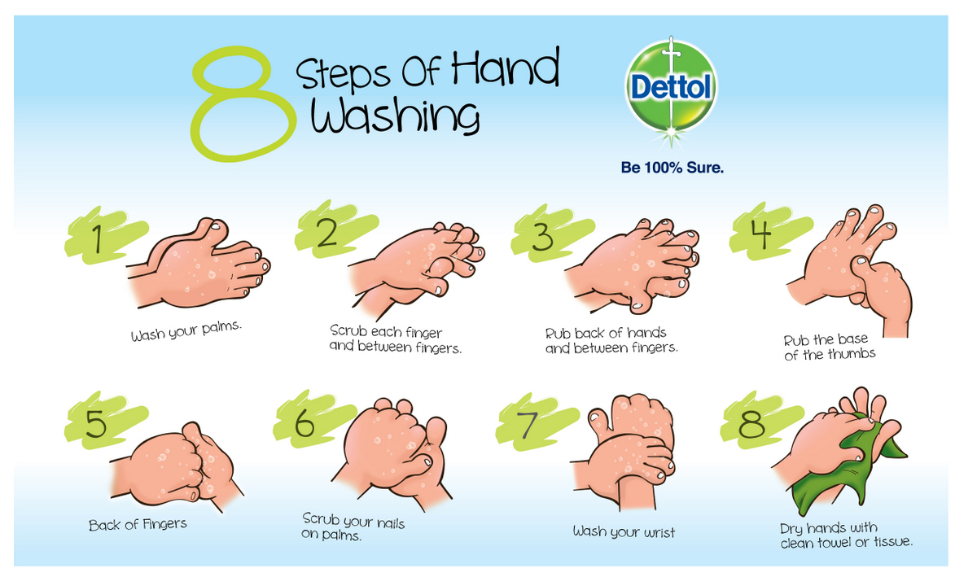
Promotion of hand washing and breastfeeding,
delivery of vaccinations, and distribution of
condoms to control the spread of
sexually transmitted diseases are
examples of common public
health measures.

Slide 10
The three main public health functions are:
The assessment and monitoring of the health of communities and populations at risk to identify health problems and priorities.
The formulation of public policies designed to solve identified local and national health problems and priorities.
To assure that all populations have access to appropriate and cost-effective care, including health promotion and disease prevention services.

Slide 11
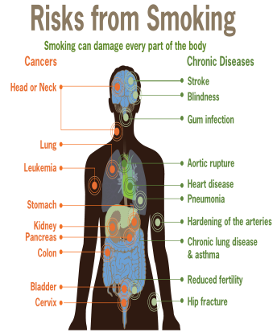
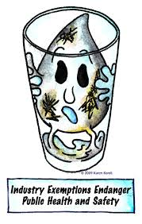
Notable public health campaigns:
Vaccination and control of infectious diseases
Motor-vehicle safety
Safer workplaces
Safer and healthier foods
Safe drinking water
Healthier mothers and babies and access to family planning
Decline in deaths from coronary heart disease and stroke
Recognition of tobacco use as a health hazard.

Slide 12
Social medicine studies the problems of public and individual health, factors which determine a health, by developments of recommendations on strengthening of health of separate groups of population and on the improvement of activity of medical establishments.

Slide 13
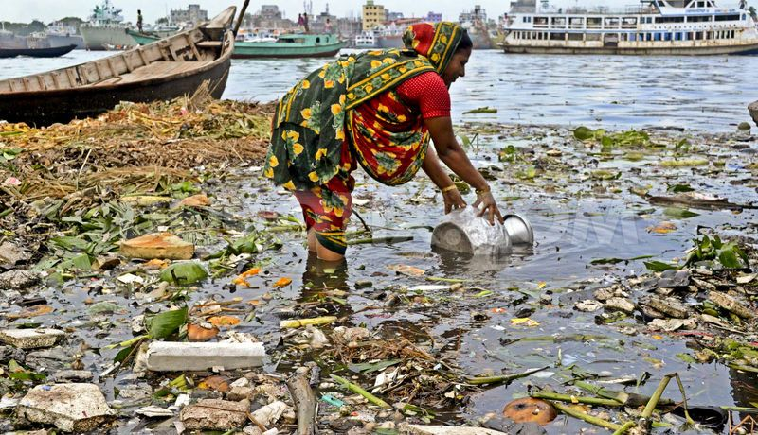
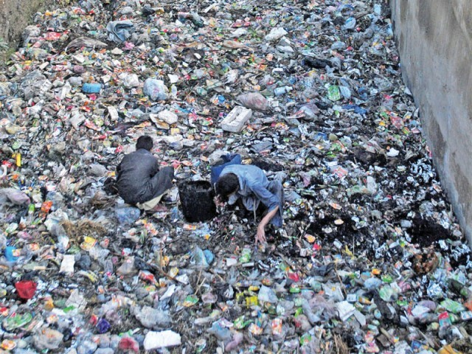
History of public health
From the beginnings
of human civilization, itwas recognized that
polluted water and lack
of proper waste disposal
spread
communicable diseases
(theory of miasma)

Slide 14
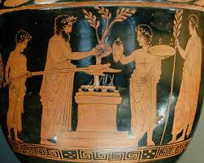
Early religions
attempted
to
regulate behavior.
That specifically related to
health, from types of
food eaten, to regulating
certain indulgent
behaviors, such as
drinking alcohol or sexual
relations.
Notes:
The establishment of governments placed
responsibility on leaders to develop public health policies and programs
in order to gain some
understanding of the causes
of disease and thus ensure
social stability and prosperity,
and maintain order.

Slide 15
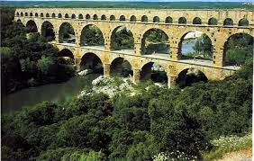
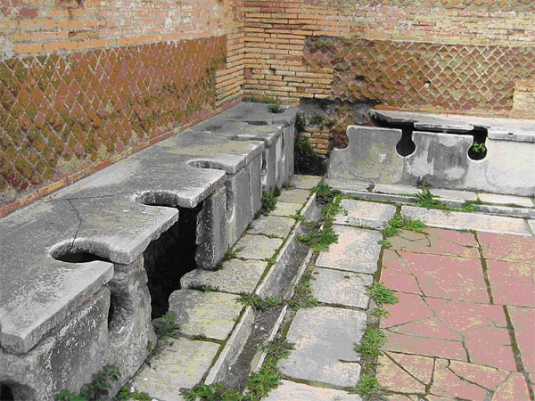
By Roman times, it was well understood that proper diversion of human waste was a necessary tenet of public health in urban areas.

Slide 16
The Chinese developed
the practice of
variolation
following a smallpox
epidemic
around 1000BC.
The practice of
vaccination
did not become
prevalent until
the 1820s,
following the work
of Edward Jenner
to treat smallpox.

Slide 17
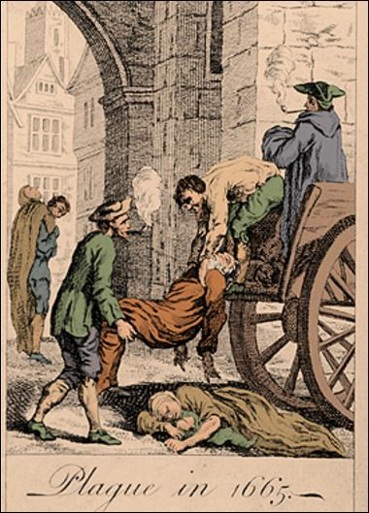
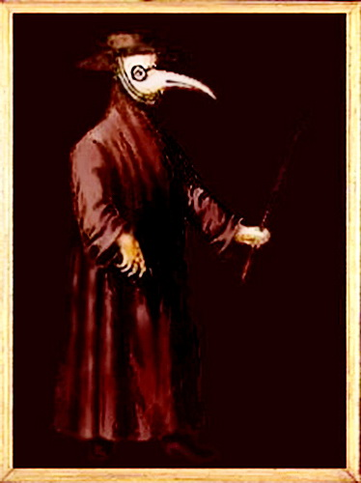
Black Death in Europe
Removing bodies
of the dead
did little to stem the
plague, which was most likely spread by
rodent-borne fleas.
Burning parts of cities
resulted in much
greater benefit, since it
destroyed the rodent
infestations.

Slide 18
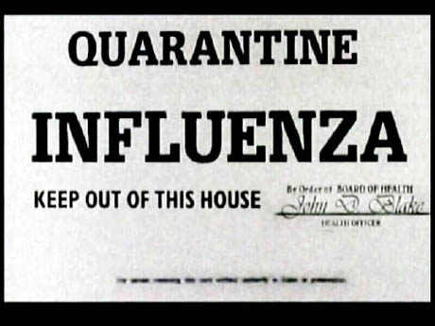
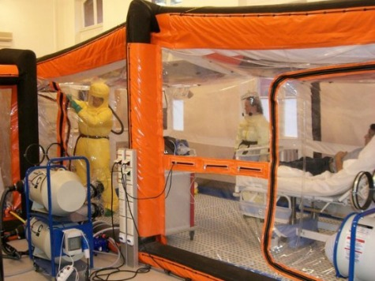
At Venice in 1348, public officials created a system of sanitary control to combat plague and other infectious diseases, with observation stations, isolation hospitals, and disinfection procedures- QUARANTINE

Slide 19
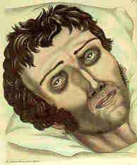
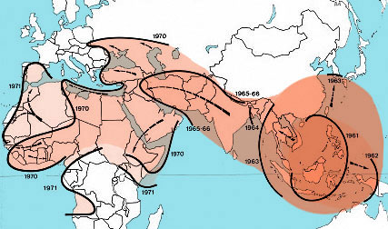
A Cholera pandemic
devastated
Europe between 1829- 1851, and was first
fought by the use of what
Foucault called
"SOCIAL MEDICINE", which focused on flux, circulation of
air, location
of
cemeteries, etc.
Dehydrated Cholera victim

Slide 20
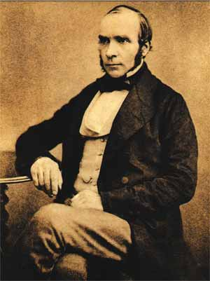
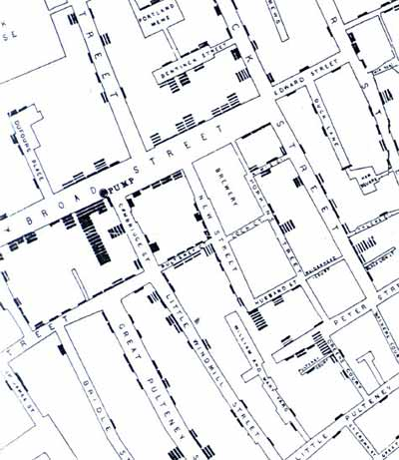
The science of
epidemiology was founded by
John Snow's
identification of a
polluted
public
water well as the
source of an 1854 cholera
outbreak in London.
Dr. Snow believed in the
germ theory of disease as
opposed to the prevailing
miasma theory.
John Snow (1813-1858)anesthetist
wrote On the Mode of Communication of Cholera(1855)
cholera is contagious
humans become sick with cholera by ingesting "morbid matter" possessing a cellular structure and the capacity to reproduce its own kind
cholera can be prevented by purifying the water supply

Slide 21
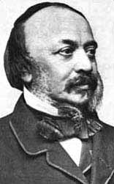
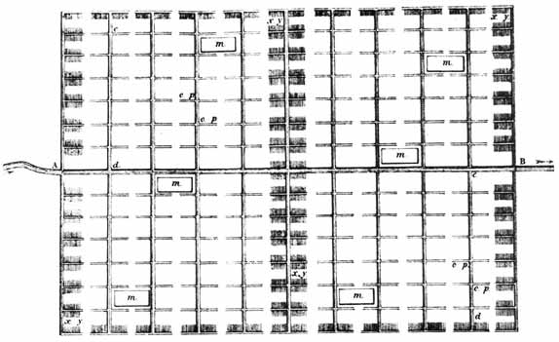
Edwin Chadwick (1800-1890)pioneer in "sanitary awakening" in England
wrote Sanitary Condition of the Labouring Population of Great Britain(1842)
principal cause of disease is miasma
disease cannot be cured
must rely on prevention
government can and must remove the causes of disease
need for ceramic water pipes
need for straightline water and sewer networks
need for water-closets for private homes and public places
need to end practice of storing night-soil in cellars
Chadwick's sanitary sewer plan

Slide 22
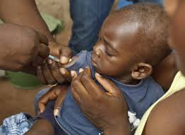
PUBLIC HEALTH ACHIEVEMENTS IN THE 20C.
Vaccination programs and control of many infectious diseases including
polio, diphtheria, yellow fever
and
smallpox;
effective health and safety policies
such as road traffic safety
and occupational safety;

Slide 23
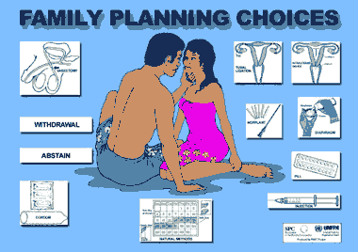
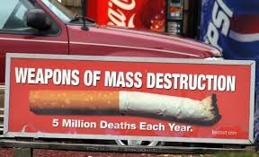
PUBLIC HEALTH ACHIEVEMENTS IN THE 20C.
improved family planning
tobacco control measures;
programs designed to
decrease
non-communicable diseases
by acting
on known risk factors such
as
a person's
background,
lifestyle and environment.

Slide 24
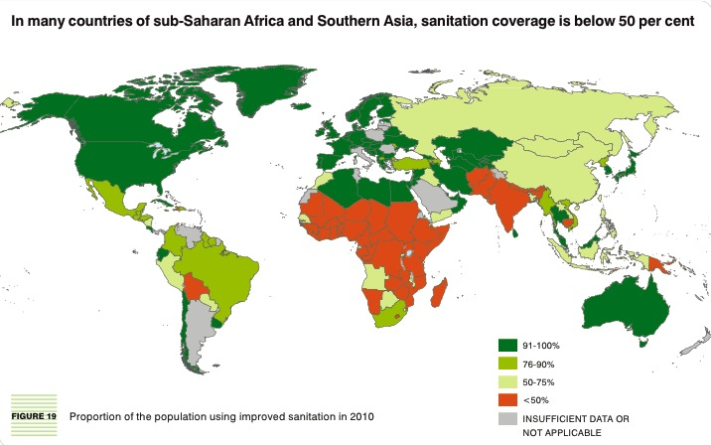
One of the major sources of the increase in average life span in the early 20th century was the decline in the "urban penalty" brought on by improvements in sanitation.

Slide 25
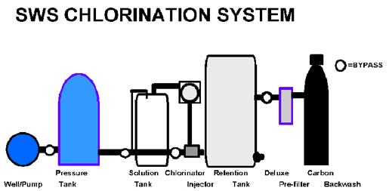
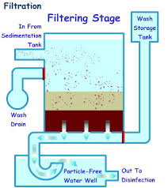
These improvements included:
chlorination of drinking water,
filtration
sewage treatment
which led to the decline in deaths caused by infectious waterborne diseases such as cholera and intestinal diseases.

Slide 26
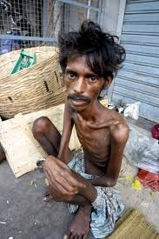
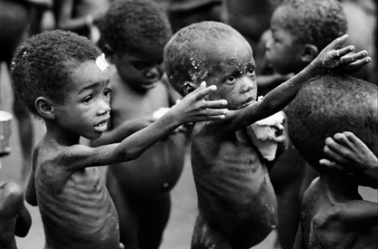
Developing world -preventable/
treatable infectious diseases and poor maternal and child health outcomes, exacerbated by malnutrition and poverty.

Slide 27
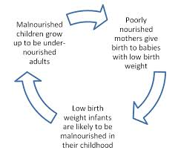
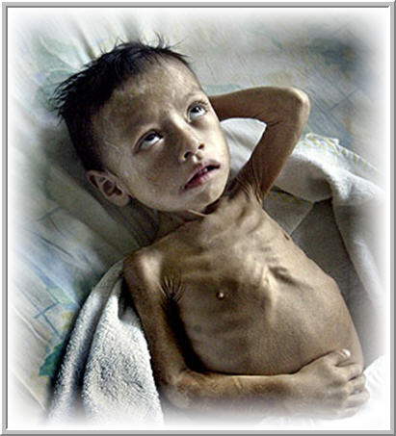
The WHO reports that a lack of exclusive breastfeeding during the first six months of life contributes to over a million avoidable child deaths each year.

Slide 28
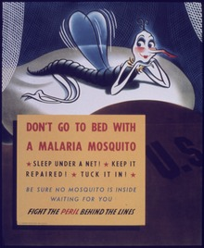
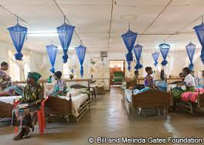
Intermittent preventive therapy aimed at treating and preventing malaria episodes among pregnant women and young children is one public health measure in endemic countries.

Slide 29
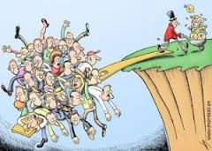
Since the 1980s, the growing field of population health has broadened the focus of public health from individual behaviors and risk factors to population-level issues such as inequality,
poverty, and education.

Slide 30
As the prevalence
of
infectious diseases
decreased through the 20th century,
public health
began to put more focus on chronic diseases such as
cancer and
heart disease.

Slide 31
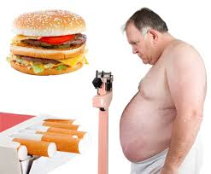
What are the risk factors of diseases?
A risk factor is potential dangerous factor of behavioral, biological, genetic, ecological, social character, surrounding and production environment, promoting probability of disease’ development, its progress and unfavorable end for a health

Slide 32
GROUPS OF RISK FACTORS
1. Socio-economic factors (terms of labour, housing terms, material welfare, level and quality of food, rest and etc.)
2. Social-biological factors (age, sex, the inherited diseases and etc).
3. Ecological and natural-climatic factors (contamination of environment, average annual temperature, presence of natural-climatic extreme factors and etc).
4. Organizational or medical factors (material well-being of population by medicare, quality of medicare, availability of medical-social help and etc).

Slide 33
The academician RAMN of Y.P.Lisitsin proposed a next grouping health risk factors (table. 1.1).
Sphere of influence of factors on a health | Groups of factors of risk | Specific gravity (in %) of risk factors
Life-style | Smoking, use of alcohol, unbalanced nutrition; stress situations (distresses); harmful terms of labour; hypodinamia; bad material conditions of life; consumption of drugs, abuse by medications; flimsiness of families, loneliness; low cultural and educational level; high level of urbanization | 49-53
Genetics, biology of man | Predisposition to the inherited illnesses and to the so-called degenerative illnesses (inherited predisposition to the diseases) | 18-22
External environment | Contamination by carcinogens and other harmful matters of air, water, soil; sharp changes of the atmosphere; promoted helicosmic, magnetic and other radiations | 17-20
Health protection | Uneffective of prophylactic measures; low quality and inopportuneness of medicare | 8-10

Slide 34
LIFESTYLE
A way of living of individuals, families (households), and societies, which they manifest in coping with their physical, psychological, social, and economic environments on a day-to-day basis.

Slide 35
For estimation of public health WOHP recommends the following indexes:
1. Deduction of gross national product on the health protection.
2. Availability of primary medico-social help.
3. Scope of population by medicare.
4. Level of immunization of population.
5. Degree of inspection of pregnant by skilled personnel.
6. State of nutrition, including nutrition of children.
7. Level of child's death rate.
8. Middle time of forthcoming life.
9. Hygienic literacy of population.

Slide 36
Health of population consists of:
1. Medico-demographic indexes.
2. Indexes of morbidity.
3. Indexes of disability.
4. Indexes of physical development of population.

Slide 37
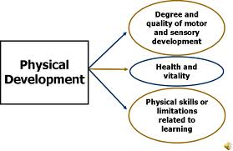
Physical development
is the complex of morphological and functional properties of organism, determining mass, closeness, form of body, structural-mechanical qualities and expressed by the supply of his physical forces.

Slide 38
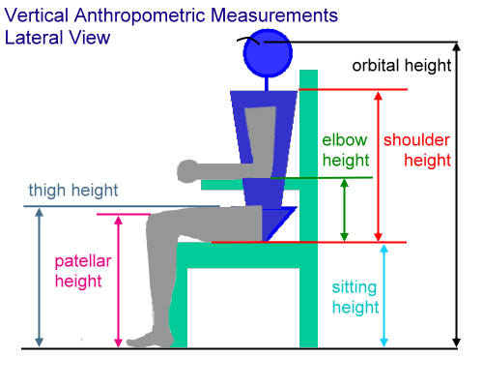
The basic signs of physical development are:
1. Antropometric, which is based on the change of sizes of body, skeleton of man and including:
а) somatometric - sizes of body and its parts;
б) osteometric - size of skeleton and its parts;
в) kraniometric - sizes of skull
2. Antroposkopic
3. Physiometric

Slide 39
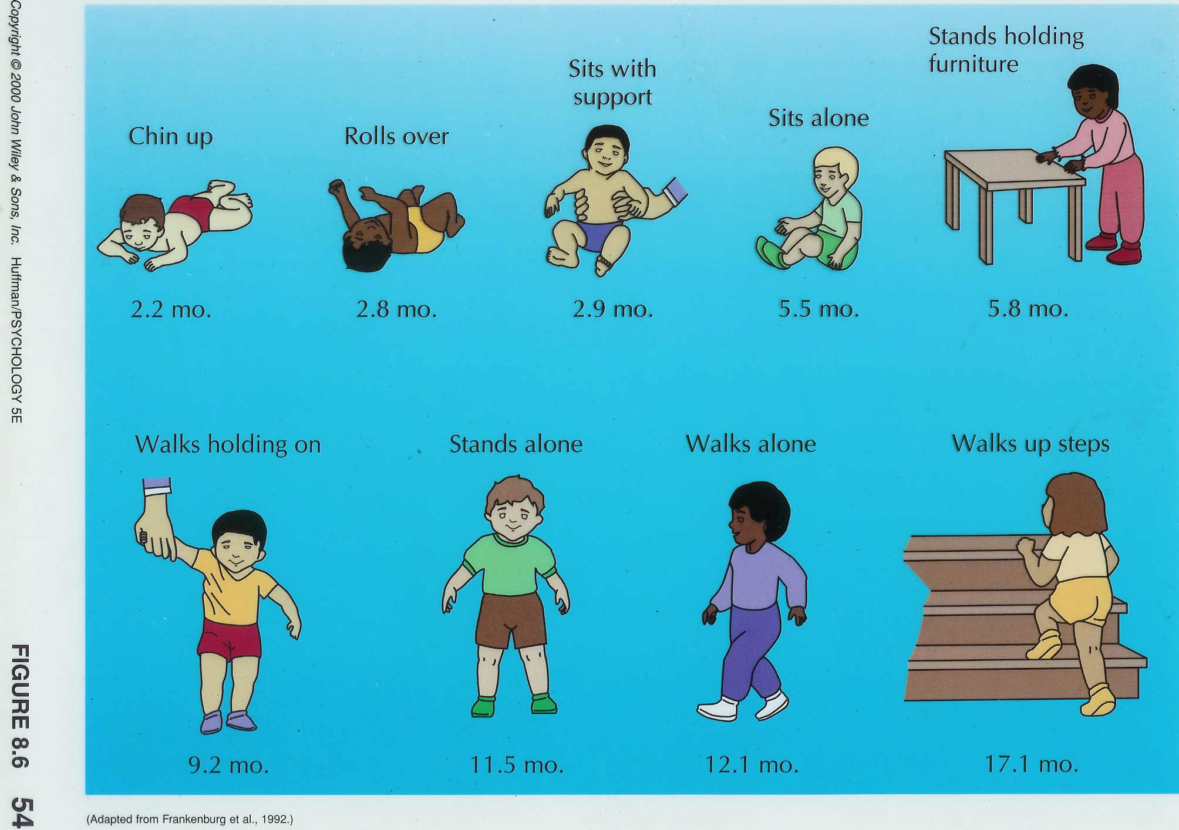
Antropometric indexes – are used for control of children’physical development and efficiency of health measures.

Slide 40
Quality of life.
Individuals’ perception of their position in life
in the context of the culture and value systems
in which they live and in relation to their
goals, expectations, standards and concerns.

Slide 41
Quality of life.
It is a broad ranging concept affected in a
complex way by the person's physical health,
psychological state, level of independence,
social relationships, personal beliefs and their
relationship to salient features of their
environment.

